Slide 1
STOCK MARKET ANALYSIS
Apple stock Forecast
DONE BY:
Group-5
Balaganesh
Kshitija Ashokrao hangarge
Sahana k muktenahalli
saka Sudheer kumar
prekshitha Shetty c
Anushka chaudhary
ronak sulthana asgari

Slide 2
INTRODUCTION
Predict the apple stock market price for the next 30 days.
There are Open, High, Low and Close prices that have been given for each day starting from 2012 to 2019 for Apple stock.
Apply data preprocessing techniques such as cleaning the data, feature engineering (adding technical indicators like moving averages), and scaling the data to make it suitable for machine learning models.
Explore various forecasting models like ARIMA, Random Forest, and LSTM (Long Short-Term Memory) networks, a type of recurrent neural network (RNN) specialized for time series data.
Evaluate the performance of these models using different metrics such as Mean Absolute Error (MAE), Mean Squared Error (MSE), and Root Mean Squared Error (RMSE).

Slide 3
OBJECTIVES
Data Collection and Exploration
Data Preprocessing and Feature Engineering
Machine Learning Model Development
Model Evaluation
Prediction and Visualization
Model Deployment

Slide 4
LIBRARIES AND TOOLS
Data Manipulation: Model Building:
1.Numpy 1.Scikit-Learn
2.Pandas
Data Visualization: Model Evaluation:
1.Matplotlib 1.Scikit-Learn
2.Seaborn
Data Preprocessing: Model Deployment:
1.Standard Scaler 1.pickle
2.Train Test Split 2.Streamlit

Slide 5
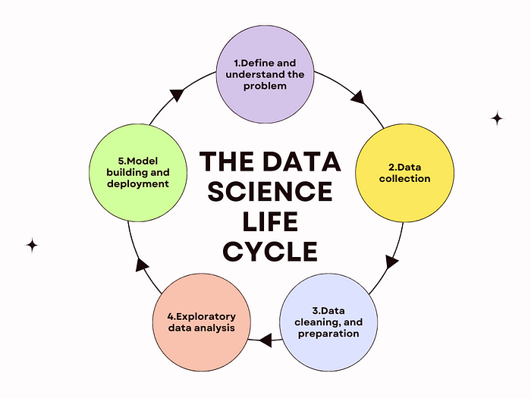
EDA (Exploring Data Analysis)

Slide 6
EDA
It involves analyzing the main characteristics of the data set, often visualizing the data, to understand its structure, discover patterns, spot anomalies, and check assumptions before applying more advanced statistical methods or machine learning algorithms
Summarizing the dataset:
By using descriptive statistics to get insights into the data, such as mean, median, mode, variance, and standard deviation.
Visualizing the data:
Employing plots like histograms, bar charts, box plots, scatter plots, and heatmaps to get a better understanding of the distribution and relationships in the data.
Identifying outliers and anomalies:
Detecting unusual data points that might indicate data entry errors or significant insights.
Handling missing values:
Understanding the nature and extent of missing data to decide on appropriate methods for dealing with them, such as imputation or removal.

Slide 7
TECHNIQUES
Handling Missing Values:
Identifying and addressing missing data through techniques such as imputation, deletion, or using algorithms that can handle missing values.
Outlier Detection:
Identifying unusual data points that can skew the analysis. Techniques include using, IQR methods, and visual inspections via box plots.
Feature Selection:
selecting the most important features using hypothesis testing and using ols method and using random forest regressor it gives the importance score of features.
Data Scaling :
using the standard scaler we scaled the data that is beneficial for our model to learn patterns amongs the data.

Slide 8
DATA OVERVIEW
The API provides a comprehensive dataset of stock prices. The dataset contains various columns, each representing a different aspect of the stock's performance
Here's a breakdown of the columns in our dataset:
Date : The date on which the data was recorded.
Open : The opening price of the stock for the day.
High : The highest price the stock reached during the day.
Low : The lowest price the stock reached during the day.
Close : The closing price of the stock for the day.
Adj Close : The adjusted closing price, accounting for stock splits and dividends.
Volume : The number of shares traded during the day.
Understanding the purpose of each column is crucial for effectively analyzing the data and building an accurate prediction model. By utilizing this data, we aim to uncover trends and patterns that can be used to forecast future stock prices.

Slide 9
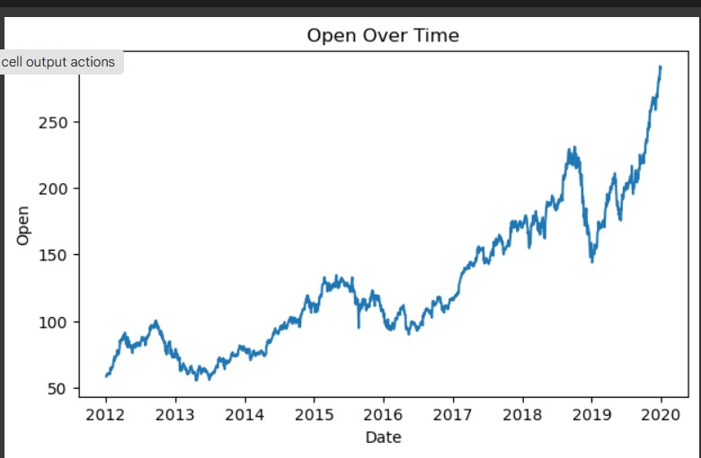
VISUALIZATIONS OPEN OVER TIME

Slide 10
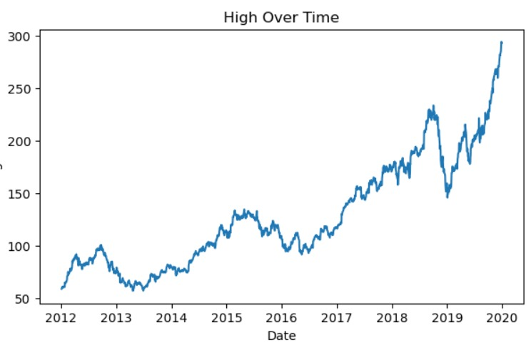
HIGH OVER TIME

Slide 11
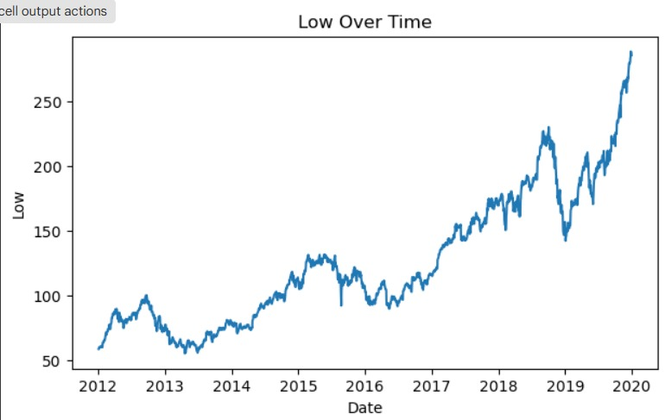
LOW OVER TIME

Slide 12
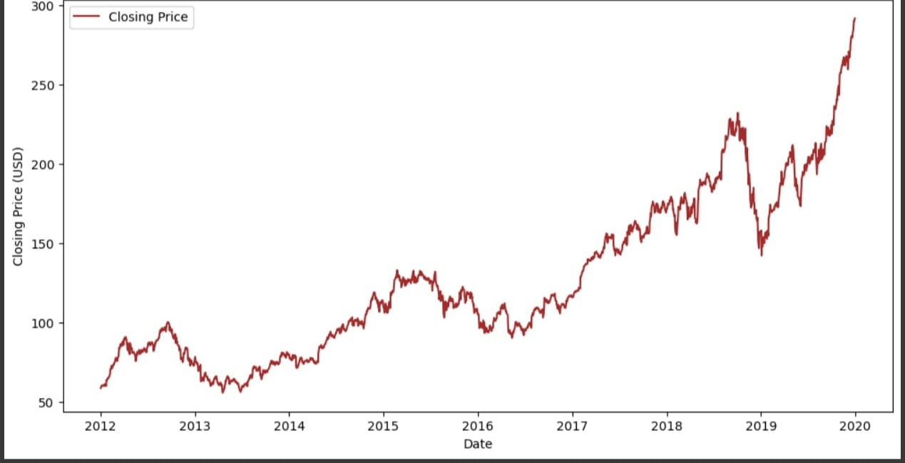
CLOSING PRICE

Slide 13
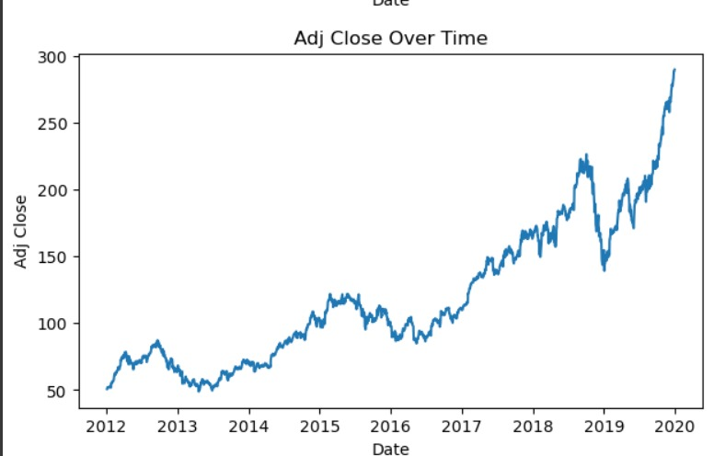
ADJ CLOSE OVER TIME

Slide 14
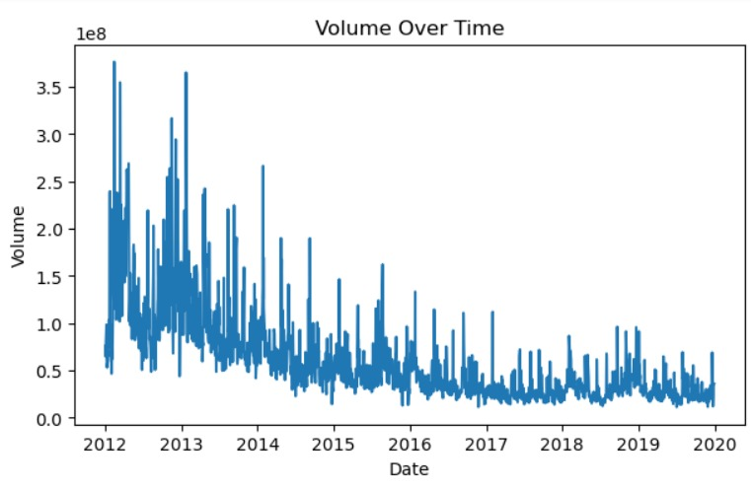
VOLUME OVER TIME

Slide 15
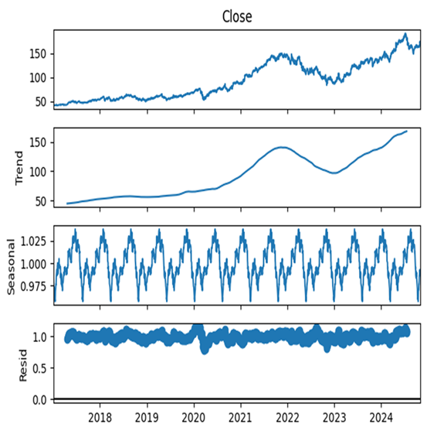
Summary of Key Insights from EDA
Long-term: TrendPositive and linear, indicating consistent growth.
Seasonality:Multiplicative, fluctuations amplify with higher prices.
Pandemic :ImpactInitial drop followed by robust recovery and growth.
Insight Description

Slide 16
MODEL BUILDING
Traditional Models
Initial attempts with linear regression, XG Boost, ARIMA, SARIMA, Random Forest, K means clustering, PCA and Agglomerative clustering models failed to fully capture the complex stock price trends and seasonality patterns observed in the data.
LSTM Model
The LSTM model, specifically designed for handling sequential data, demonstrated superior performance in capturing the temporal dependencies and intricate patterns present in stock prices, leading to its selection as the preferred model for prediction.

Slide 17
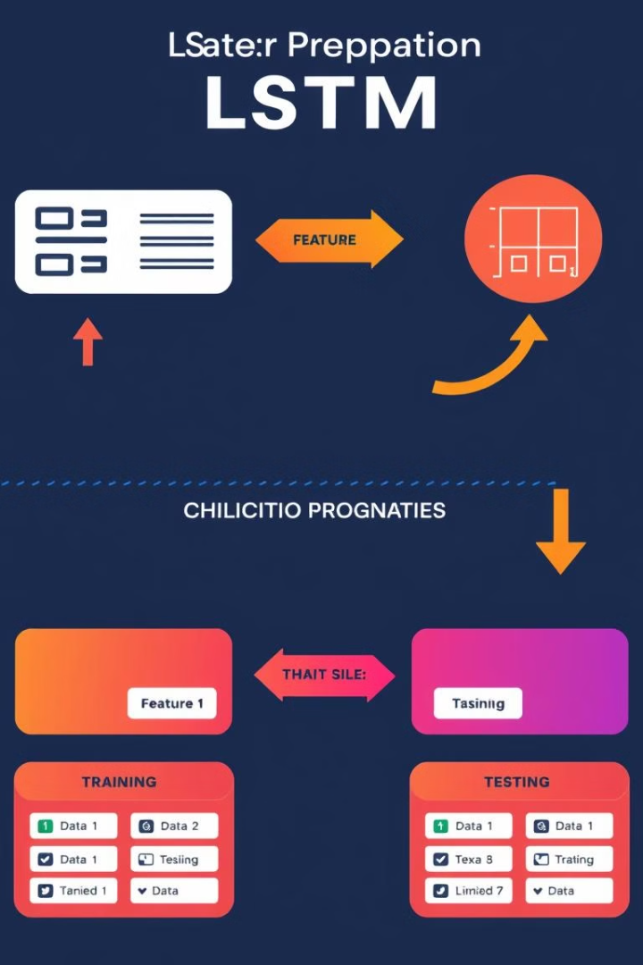
Preparing Data for LSTM
Data Transformation:
The data was transformed to include the three-lag values of the "Close" column, providing the LSTM model with additional context and historical information for making predictions.
Training and Testing Split:
The dataset was divided into training and testing sets, with 80% of the data allocated for model training and 20% reserved for evaluating the model's performance on unseen data.

Slide 18
LSTM Model Architecture
Input Layer:
Hidden Layers:
Output Layer:
The input layer of the LSTM model accepts the previous time steps of the transformed data, providing the network with a sequence of historical information to process.
The model employs two hidden layers with LSTM units, allowing it to learn and remember long-term dependencies and capture the intricate patterns present in the stock price data.
The output layer of the model predicts the stock price based on the learned patterns and the input sequence, providing a forecasted value for the stock price in the future.

Slide 19
Model Training and Performance
Training Process | The LSTM model was trained using a dataset of historical Google stock prices, encompassing various time periods and market conditions. The training process involved defining model parameters, including the number of layers, hidden units, and activation functions.
Optimizer and Loss Function | The Adam optimizer, a popular choice for deep learning models, was employed to minimize the Mean Squared Error (MSE) loss function. This combination aimed to optimize the model's weights by iteratively adjusting them to reduce prediction errors.
Epochs and Batch Size | The model was trained for 50 epochs, with each epoch representing a complete pass through the training data. A batch size of 64 was used, dividing the data into smaller batches for efficient processing and gradient descent updates.

Slide 20
Model Evaluation
MAPE
Accuracy
MSE and RMSE
The model achieved an accuracy of 97.38%, indicating its ability to predict AAPL stock prices with a high degree of precision. This accuracy score reflects the model's ability to capture complex patterns and relationships in the data.
The Mean Squared Error (MSE) of 13.39 and the Root Mean Squared Error (RMSE) of 3.66 provide quantitative measures of the average prediction error. Lower MSE and RMSE values indicate better model accuracy, suggesting that the LSTM model effectively captured the underlying trends in the stock price data.
The Mean Absolute Percentage Error (MAPE) of 2.62% represents the average percentage error of the model's predictions. A lower MAPE score signifies higher prediction accuracy, demonstrating the model's effectiveness in capturing the fluctuations and variations in the stock prices.

Slide 21
MODEL DEPLOYMENT
Deployment Process
Stream lit was chosen for its user-friendly interface and ease of deployment. The LSTM model, along with necessary data preprocessing and visualization components, was integrated into a application. This process involved leveraging libraries and functions to create an interactive web-based interface.
Features
The application provides users with a range of features, including the ability to input historical stock data, visualize predicted stock prices, and access real-time forecasts. The application allows users to explore various parameters and observe their impact on prediction accuracy.

Slide 22
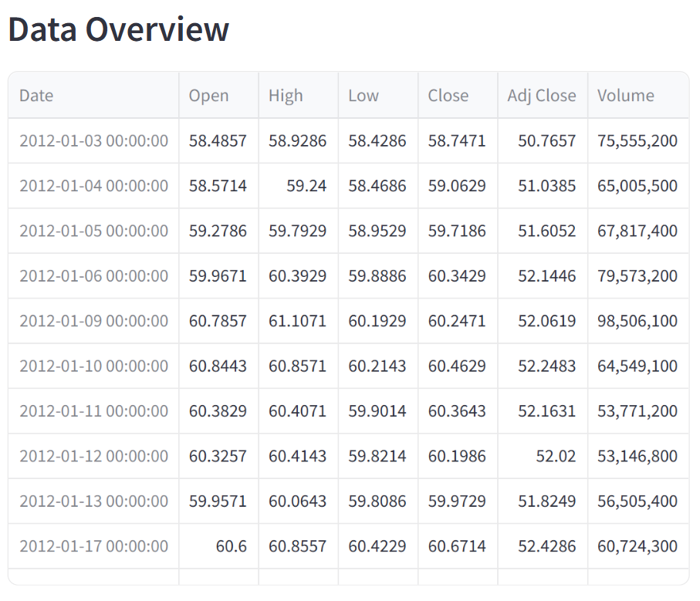

Slide 23
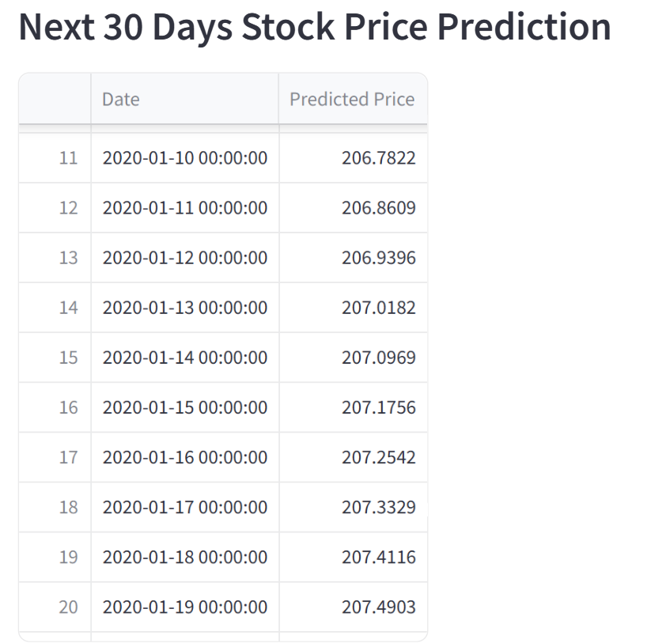

Slide 24
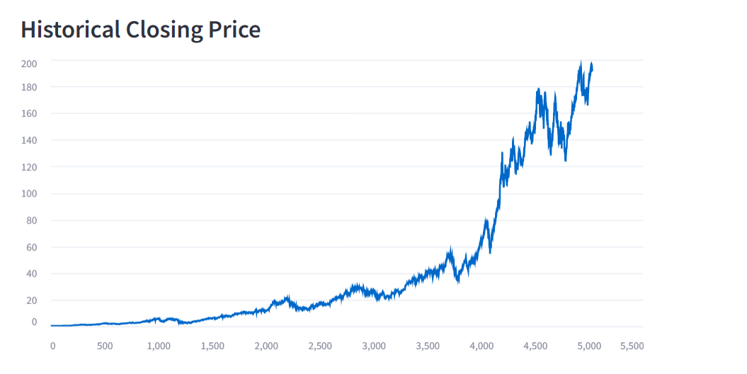

Slide 25
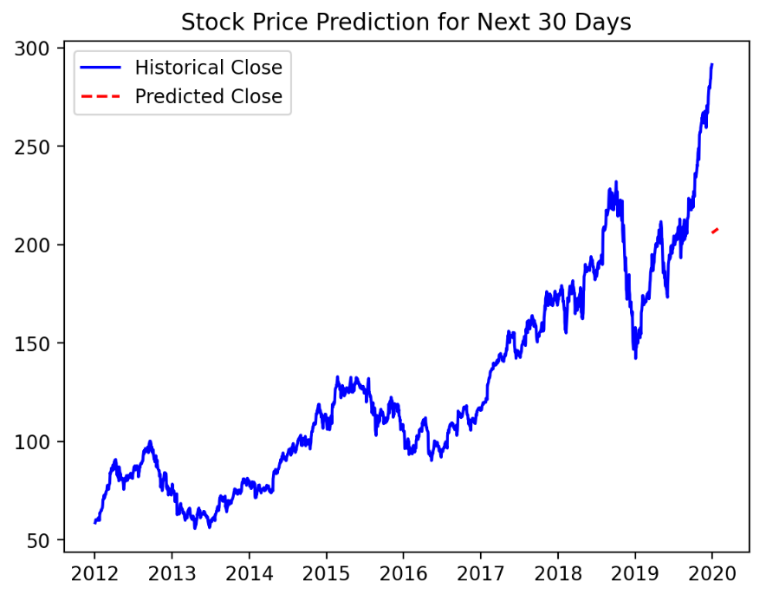

Slide 26
CHALLENGES AND LEARNING
Challenges:
Selecting the important features and best model.
Setting up Stream lit for deployment.
Underfitting and Overfitting Of Model
Learnings:
Importance of hyperparameter tuning for improved accuracy.
Effective feature engineering techniques.
Making the model pipeline save the lot of time for same process

Slide 27
THANK YOU!

